Slide 1
Submitting Absence Request in Conjunction with PCS

Slide 2
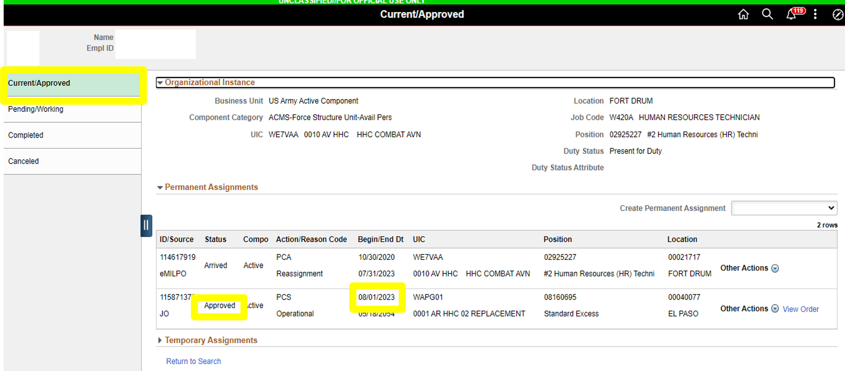
Absence Request
Service member has an approved assignment with a report date of 1 August 2023
View Orders

Slide 3
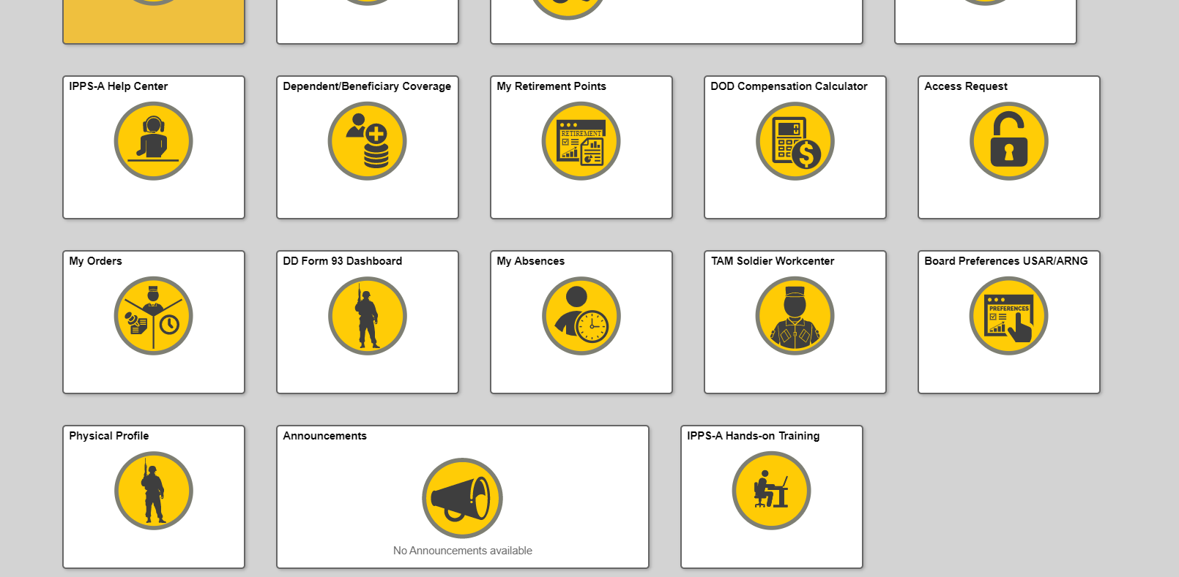
Absence Request (without House Hunting Absence)
User, via Self-service, will navigate to the Absence Request tile and submit for an Absence Request in Conjunction with PCS

Slide 4
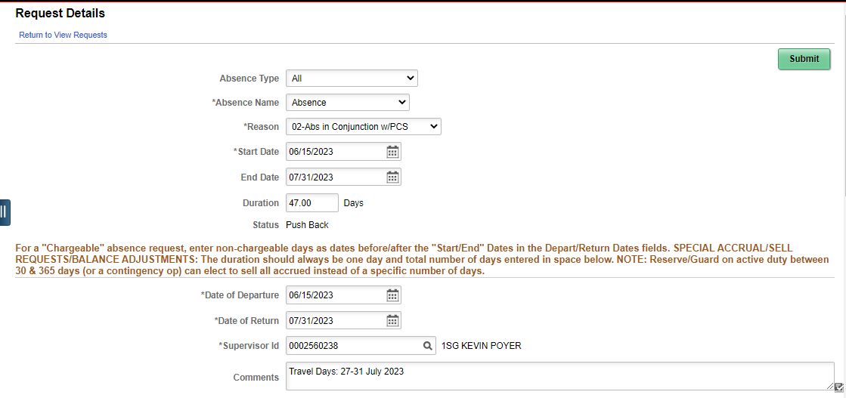
Absence Request (without House Hunting Absence)
IAW IPPS-A User Manual, Authorized Travel days are either automatically determined by DTOD or manually entered by the unit when processing the arrival at the gaining installation.
In the above example, it appears as if the Service member will be charged 47 days, however, during the arrival process, the ATD will automatically calculate based on losing and gaining unit zip codes. In the event the days need to be adjusted, the in-transit grid will allow the HR Pro to adjust, as necessary prior to processing the absence through DJMS.
It is not necessary to annotate the ATD in the comments because it’s automatically calculated, but you may do so as shown in the above example. It is optional.
Absence may only require unit commander approval (pending unit SOP/policies
Notes:
Key Notes:
-Authorized Travel Days (ATD) are either automatically determined by Defense Table of Official Distances (DTOD) or manually entered by the unit when processing the arrival.
-In the above example, it appears as if the Service member will be charged 47 days, however, during the arrival process, the ATD will automatically calculate based on losing and gaining unit zip codes. In the event the days need to be adjusted, the in-transit grid will allow the HR Pro to adjust, as necessary prior to processing the absence through DJMS.
-It is not necessary to annotate the ATD in the comments because it’s automatically calculated, but you may do so as shown in the above example. It is optional.
-Absence may only require unit commander approval (pending unit SOP/policies

Slide 5
Absence Request (with House Hunting Absence)
User, via Self-service, will navigate to the Absence Request tile and submit for an Absence Request in Conjunction with PCS

Slide 6
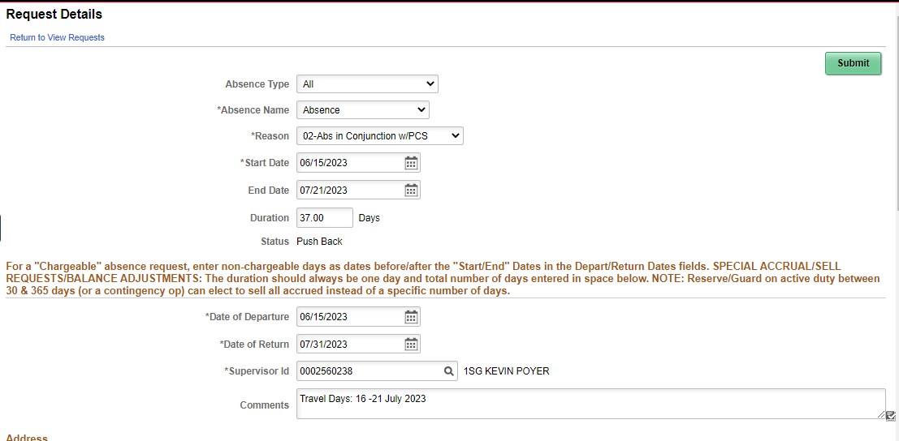
Absence Request (with House Hunting Absence)
Enter Chargeable days on top
Enter entire absence period
**Reminder*** : Authorized Travel Days (ATD) will be automatically determined by Defense Table of Official Distances (DTOD) or manually entered by the unit when processing the arrival. The 37 chargeable days in the example above will adjust upon arrival to gaining unit.
Absence may only require unit commander approval (pending unit SOP/policies
Notes:
Key Notes:
**Reminder*** : Authorized Travel Days (ATD) will be automatically determined by Defense Table of Official Distances (DTOD) or manually entered by the unit when processing the arrival. The 37 chargeable days in the example above will adjust upon arrival to gaining unit.
-Absence may only require unit commander approval (pending unit SOP/policies

Slide 7
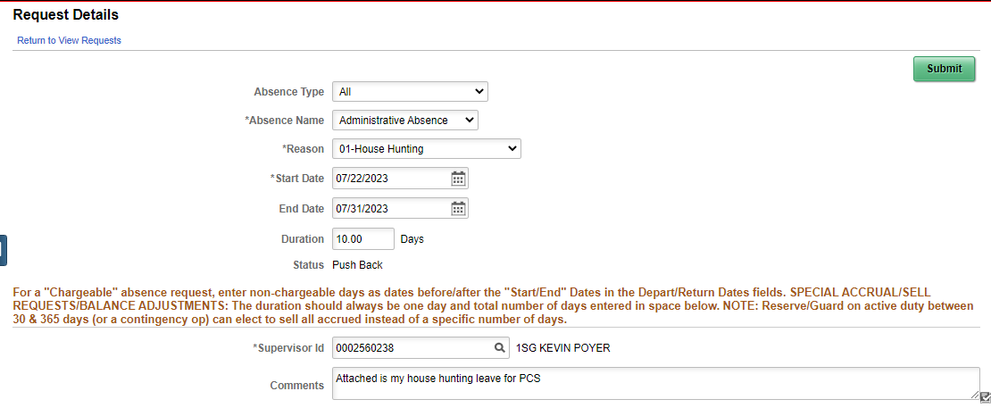
Absence Request (with House Hunting Absence)
Enter the House Hunting dates as shown above.
The dates of the House Hunting request MUST start before the PCS Absence or requested after arrival to the new duty station.
House Hunting may be entered before or after the ‘Absence in conjunction with PCS’ period as long as the ‘Absence in conjunction with PCS’ has the entire absence period annotated as shown in the previous slide.
Ensure the proper approval authority signs the request for House Hunting.
Recommend having Housing Hunting signed prior to approving PCS Absence.
Notes:
Key Notes:
-Enter the House Hunting dates as shown above.
-House Hunting may be entered before or after the ‘Absence in conjunction with PCS’ period as long as the ‘Absence in conjunction with PCS’ has the entire absence period annotated as shown in the previous slide
-Ensure the proper approval authority signs the request for House Hunting. Recommend having Housing Hunting be signed prior to approving PCS Absence.

